Slide 1
BEEER:
Distributed Record and Replay for Medical Devices in Hospital Operating Rooms.
Avesta Hojjati, Yunhui Long, Soteris Demetriou, Carl A. Gunter
#HotSoS 2019

Slide 2
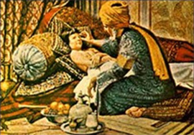
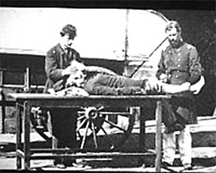
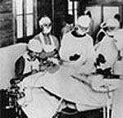
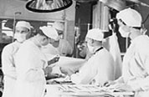
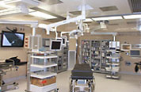
BEFORE THE OPERATING ROOM:
MAGICIANS, PRIESTS, AND PHYSICIANS
Notes:
operating rooms have progressed greatly throughout the years.
In ancient times, medical examinations were carried out by magicians and priests
In world war I, medical surgeries were performed in battlefield tents
- In recent years, the evolution of operating room has speed up. Now, operating rooms are full of connected medical devices, and it is more similar to a data center than anything else before

Slide 3
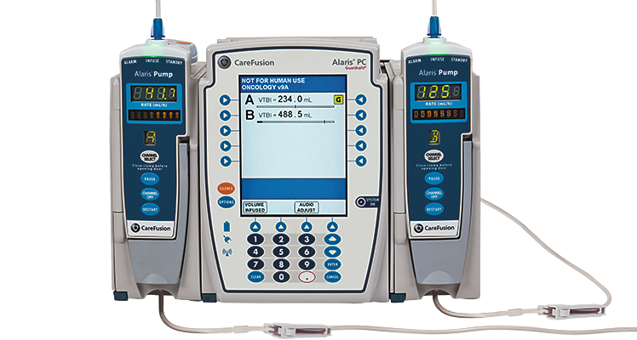
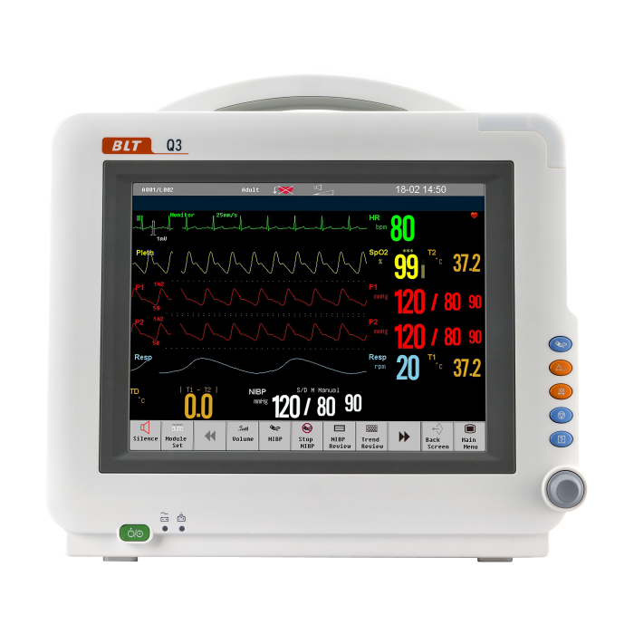
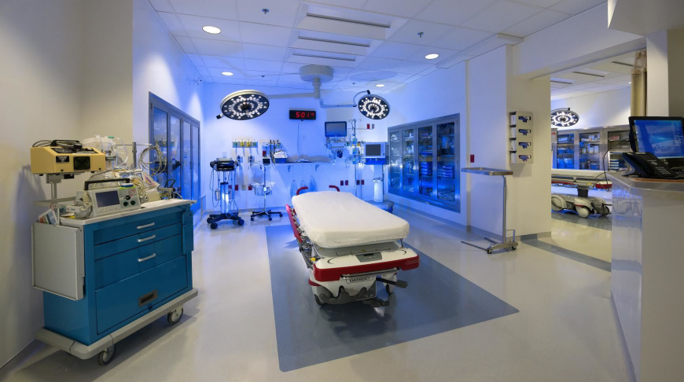
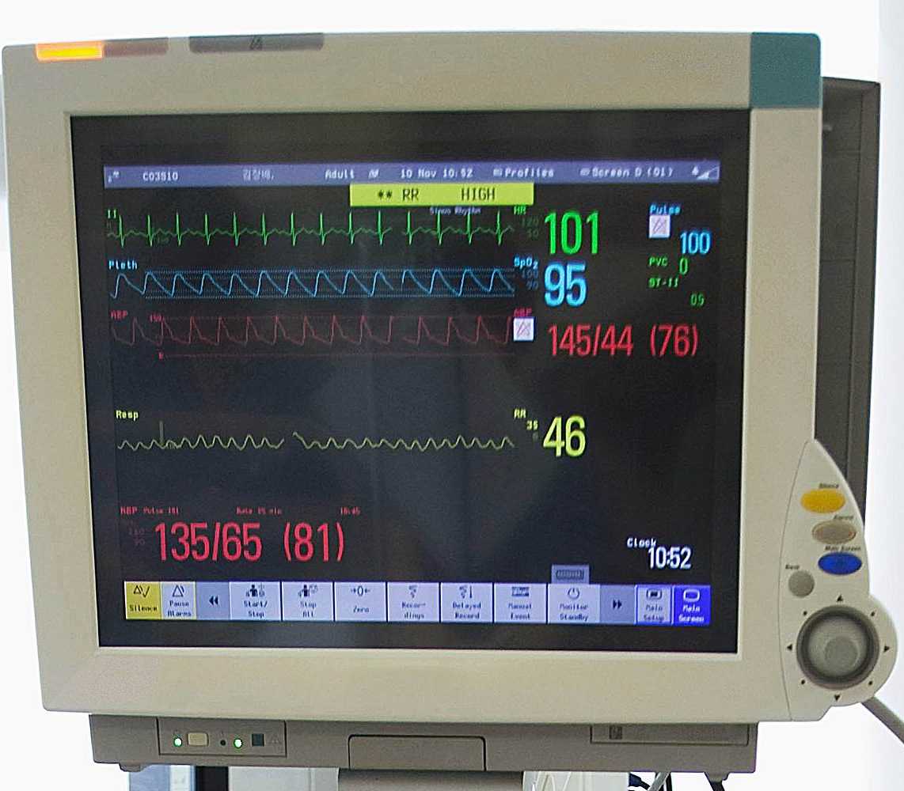
The future of Operating Rooms
System integration and technical standards
Telecollaboration
Surgical Robotics
Intraoperative Diagnosis, Monitoring, and Imagining
Notes:
Connection is also the future of operating rooms. With the development of medical devices, modern operating rooms rely more and more on communication between devices.

Slide 4
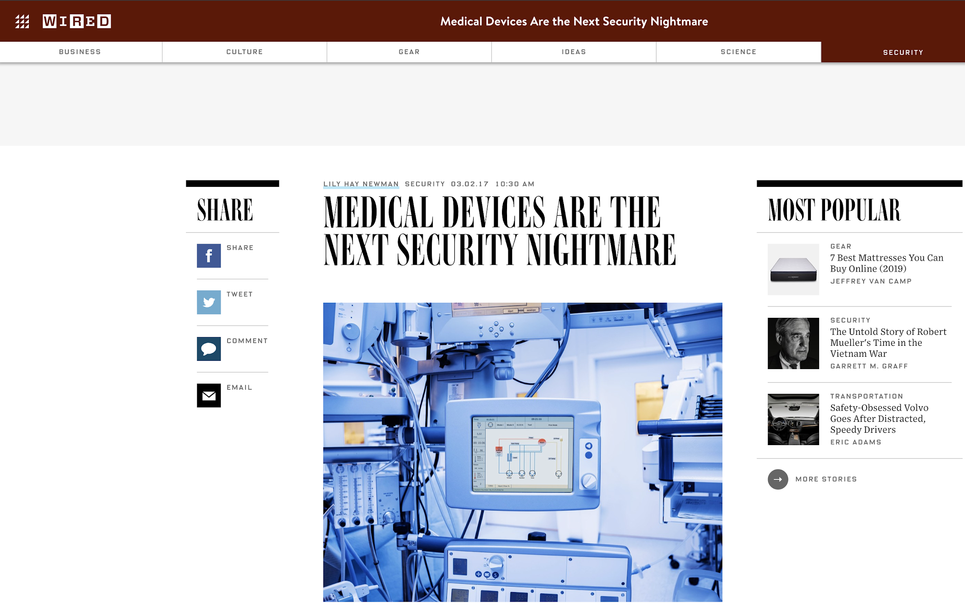

Slide 5
A Target market for attackers:
On average each US hospital has 10-15 connected devices per bed.
53% percent of healthcare facilities and 43% of manufacturers do not carry out any tests on these devices.
Only 51% of device makers abide by the FDA guidelines.
An LA hospital paid out $17,000 when hackers took control of their computer
Notes:
Large attack surface
Little or no defenses against potential attacks
Severe consequences of these attacks bring huge profits for attackers

Slide 6
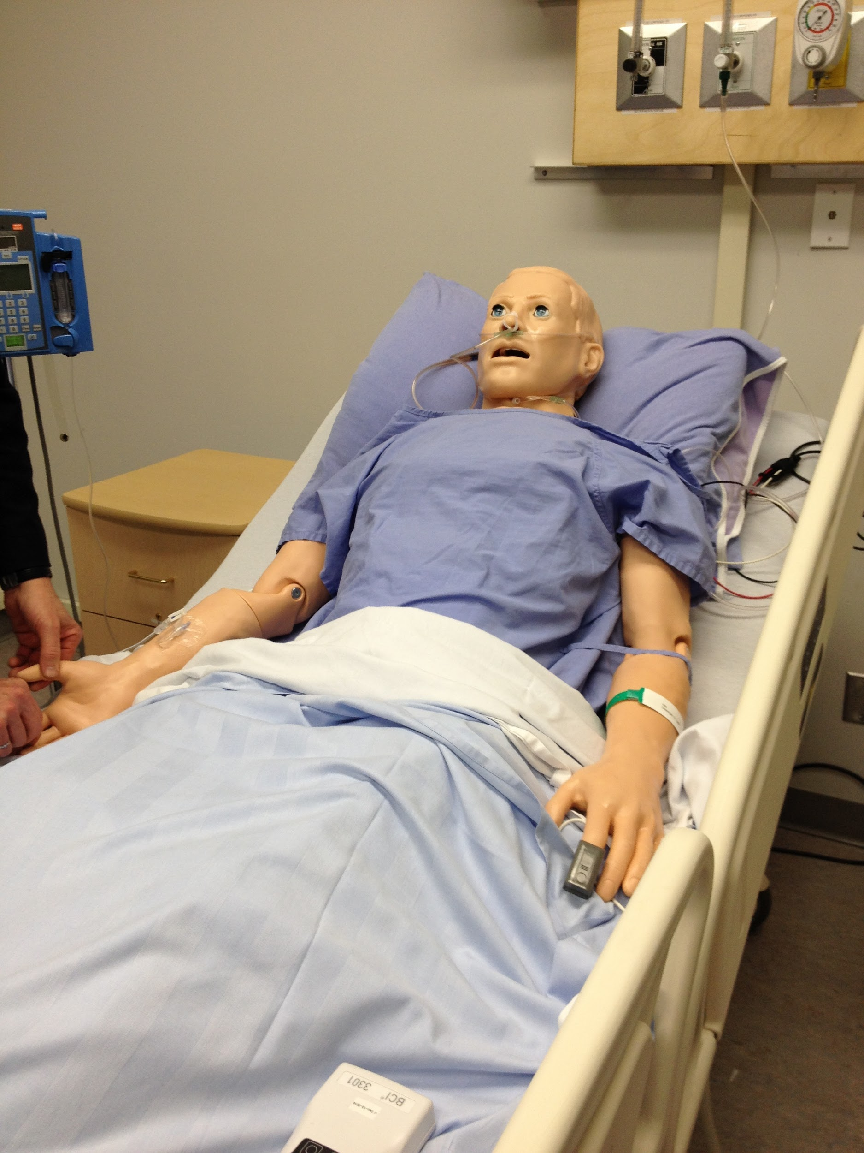
Notes:
Talk about attacks on attacks on IP

Slide 7
Notes:
Talk about the libraries that the infusion pump needs and how they can be provided by the main server

Slide 8
Possible Solutions:
Deploying Intrusion Detection Systems (IDS) such as active monitoring
Deploying Intrusion Prevention Systems (IPS) such as firewalls
Notes:
Talk about single device record and replay

Slide 9
Possible Solutions:
Deploying Intrusion Detection Systems (IDS) such as active monitoring
Deploying Intrusion Prevention Systems (IPS) such as firewalls
Recoding and auditing the device logs
Notes:
Talk about single device record and replay

Slide 10
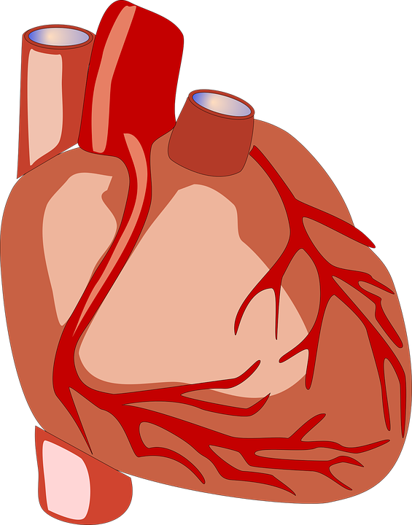
In modern operating rooms, the output of one device will be the input of another device.
Notes:
discuss how this devices are being use in a hospital

Slide 11
Which device was actually compromised?
Notes:
discuss how this devices are being use in a hospital

Slide 12
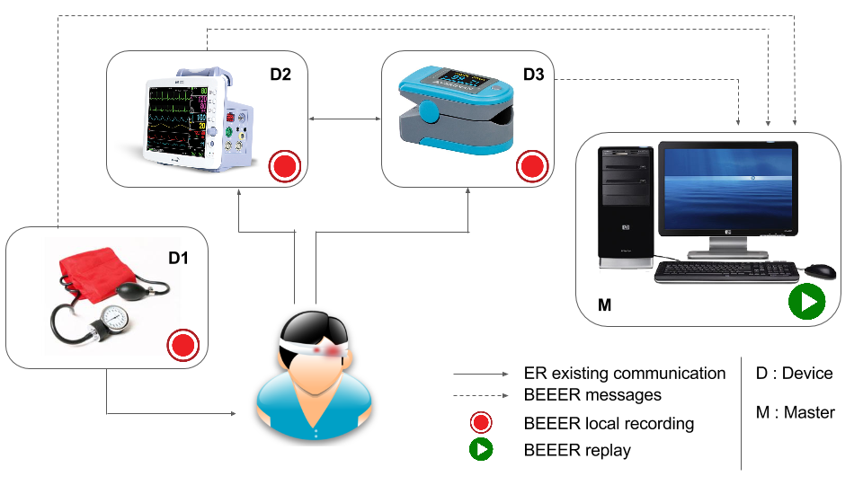
Proposed Solution:
BEEER’s Architecture
Distributed Record and Replay (DRNR) with ability to record each device individually with a universal time and capability of replaying an incident from each device in parallel
Notes:
Talk about BEEER high level

Slide 13
BEEER Overview
Record
We modified Arnold (a record and reply system for single devices)
Two approaches for recording
Device Synchronization with NTP
Projection Protocol
Replay
Log Merging
Token Distribution

Slide 14
Goal of Distributed Recording
Traditional Distributed System:
Local Causality:
Preserve event ordering on the same device
Message Causality:
Receiving a message m is ordered after sending m
Cyber Physical System (CPS):
CPS Causality
Notes:
To preserve the causal ordering of events

Slide 15
Onset
Onset: The time it takes for a medication to have physiological effect on a patient.
Onset of Insulin:
5 - 120 minutes

Slide 16
CPS Assumption
CPS (Cyber Physical System) Assumption:
Onset time > Network Latency
CPS Causality:
Preserve ordering of events with intervals greater than t_{cps}
CPS Causality

Slide 17
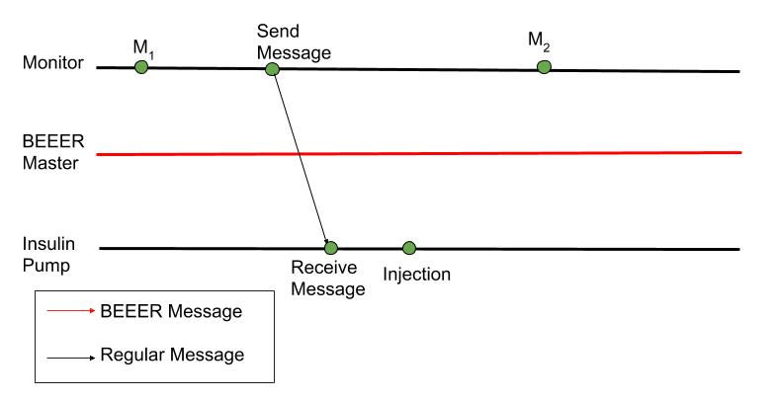
Projection Protocol: Example

Slide 18
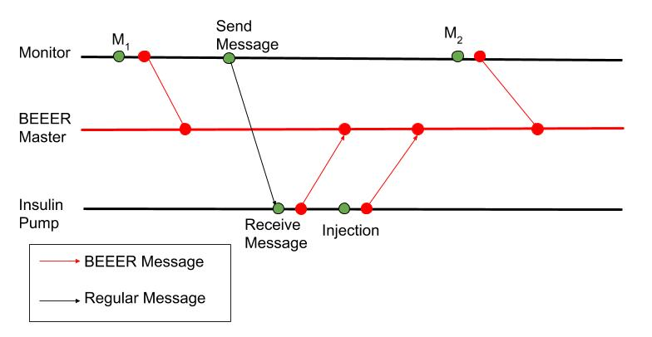
Projection Protocol

Slide 19
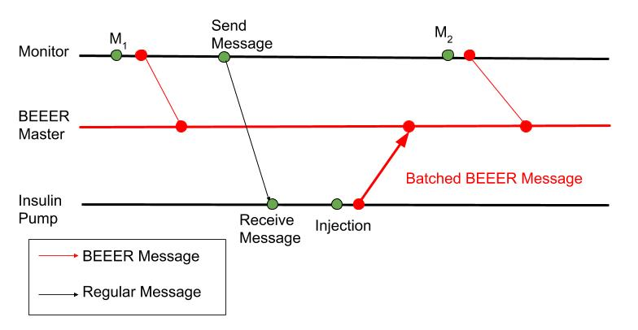
Projection Protocol: Batching

Slide 20
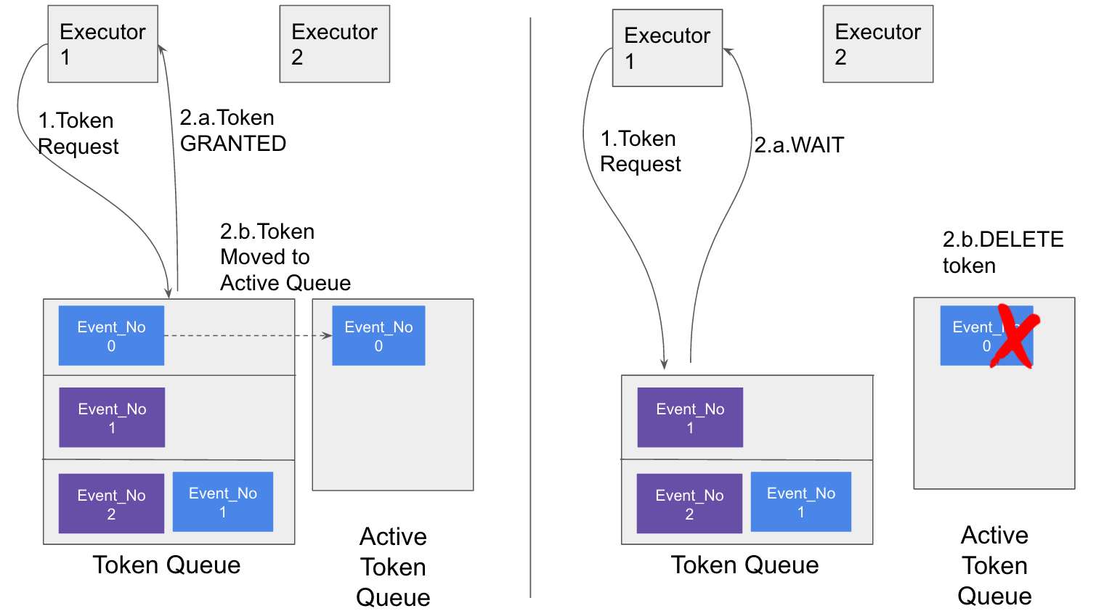
Replay: Token Distribution
Notes:
Before replaying, request for token
Delete token in active token queue, after finishes
Further token requests need to wait until there is no active token in the queue
Batch consecutive tokens from the same executor

Slide 21
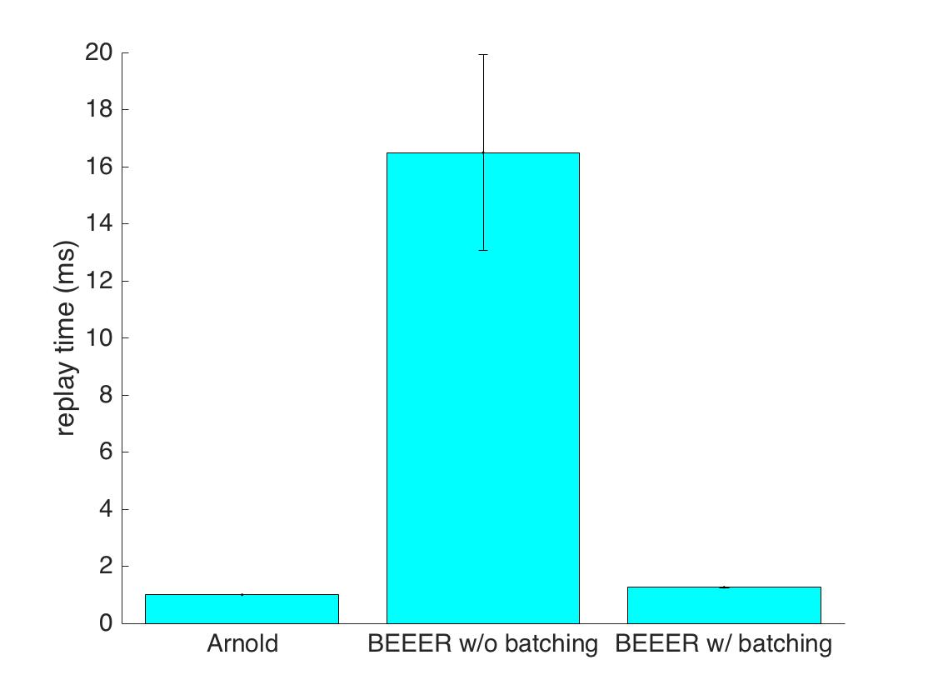
Evaluation: Replay

Slide 22
Summary
Medical equipment are one of the most vulnerable embedded devices
We designed, deployed, and evaluated a Distributed Record and Replay (DRnR) solution that records every equipment in an Operating Room
Our solution is available for other embedded devices as long as they support a form of Linux as their operating system
Notes:
Talk about single device record and replay

